Slide 1



Secure Learning Management System With Content Encryption
And Student Performance Prediction

Slide 2

Table of Contents
Points for discussion:
Introduction
Problem Statement
Objectives
System Architecture
Website Overview
Student Page
Teacher Page
Content Encryption
Student Data Anlaysis
Model Building
Performance Prediction
Reslt and evaluatiom
Future work
Conclusion

Slide 3


Introduction
The project focuses on creating a Secure E-Learning Management System.
It ensures secure content delivery through advanced encryption techniques.
The system analyzes and predicts student performance using Neural Networks.
Aim: To enhance the online learning experience by integrating security, analytics, and personalization.

Slide 4
Problem Statement
Challenges in Modern E-Learning Systems
Content and user
Privacy
Student Performance Insights
Dependency on External Content
Ensuring secure access to educational materials and protecting user data from breaches.
Lack of robust tools to analyze and predict student outcomes effectively.
Reliance on YouTube videos and Scribd PDFs instead of hosting proprietary content.

Slide 5


Objectives
Develop a Secure E-Learning Platform
Protect content using encryption techniques
Create a Personalized Dashboard
Enhance Content Delivery
Analyze and predict student performance using Neural Networks.

Slide 6

Website overview
Displays content access limited to signed-in users.
Welcoming interface with user-friendly design.
Navigation bar includes:
Home: Main page with key information.
About: Details about the project.
Contributors: Team member acknowledgments.
Search Bar: For quick content lookup.
Sign In/Sign Up: Access control for users.

Slide 7



STUDENT PAGES
Student Features
Navigation Bar Options:
Home Page: Displays all available courses for enrollment.
Courses: Lists courses the student has enrolled in.
Assignments: Enables assignment submission for enrolled courses.
Study Material: Allows downloading of PDFs and other materials.

Slide 8
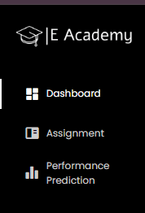
TEACHER
PAGES
Navigation Bar Options:
Dashboard: Overview of teaching activities.
Assignment Results: Displays submissions from students.
Performance Prediction: Analyze and predict student performance using the model.
Tools to streamline teaching and student monitoring.

Slide 9
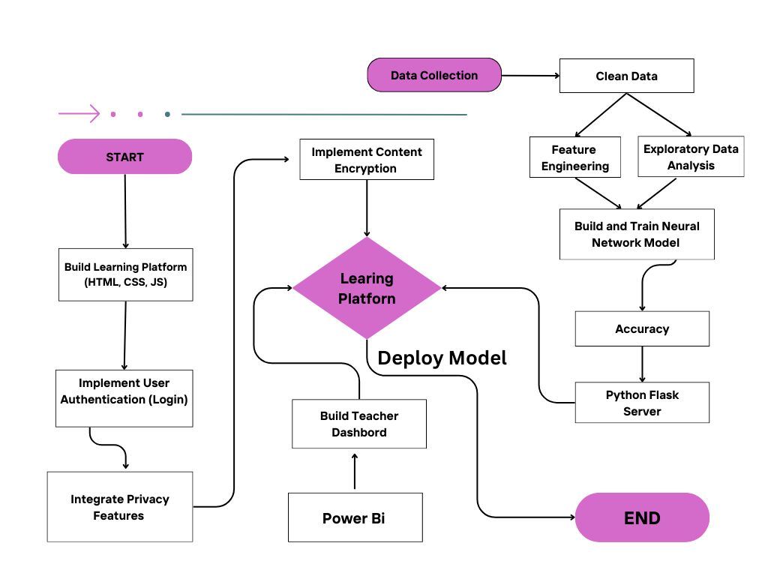
System Architecture

Slide 10







Encryption Techniques
Cipher Substitution for encrypting content.
bcrypt for securing passwords and user credentials.
Content Encryption
Privacy Enhance Mode
Secure embedding of YouTube videos and Scribd PDFs.
Protecting Content and User Data
Data Protection
Encrypt all sensitive information, including user and content data, to prevent unauthorized access.

Slide 11

Student Data Analysis
Model Building
Analyzing Student Performance
Pre-Processing
DATA COLLECTION
Collect data from external sources like Kaggle
PERFORMANCE METRICS
Analyze key metrics: test scores, attendance, and engagement levels.
Data
PREDICTION
Use Neural Networks (NN) to predict student performance based on historical data.

Slide 12
MODEL BUILDING
Building the Prediction Model using MLP and ANN
MLP (Multilayer Perceptron)
ANN (Artificial Neural Network)
A type of Artificial Neural Network (ANN).
Uses multiple layers of neurons to model complex relationships.
Effective for regression and classification tasks.
Mimics the human brain’s neural structure to identify patterns.
Trained to predict student performance based on historical data.
Includes hidden layers and activation functions for better accuracy.

Slide 13
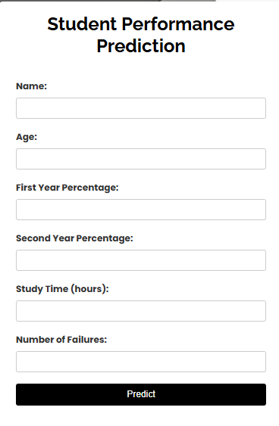
Performance Prediction
Users input details like name, age, marks, study hours, and failures.
The Neural Network model processes inputs to predict student performance.
Predicted results are displayed on the interface.
All input and prediction data are stored securely in MongoDB.

Slide 14

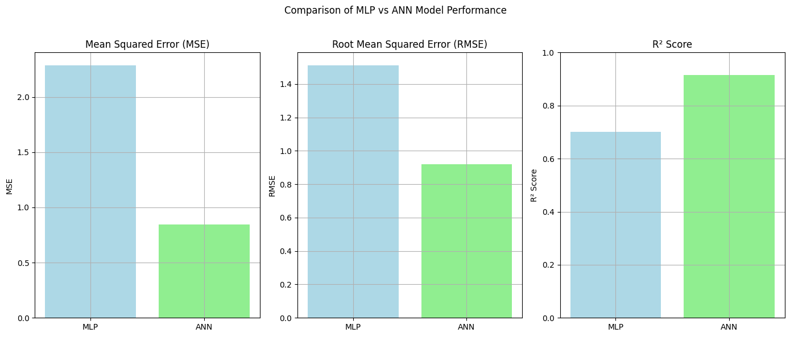
Result and Evolution
Comparison of ANN and MLP Performance
R² Score: ANN’s score is close to 1, indicating high accuracy.

Slide 15
Future Scope
Enhancements and Opportunities
1
2
3
4
Improve content encryption methods.
Enhance prediction models with more factors.
Create personalized dashboards for students
Develop educational games to boost student engagement.

Slide 16

Conclusion
Successfully developed a secure E-learning
Management System.
Integrated content encryption to protect
educational materials.
Used Neural Networks to predict student
performance accurately.
Provided insights for better decision-making in
education.
Enhanced the overall learning experience by ensuring
security and personalization.

Slide 17




KEY PEOPLE
Arman Qureshi
Piyush Negi
Developed the web interface for the E-learning platform.
Ensured the website's responsiveness across multiple devices.
Ansh Arora
Karan Singh
Worked on performance model development and prediction using ANN.
Built Power BI dashboard and performed data analysis.

Slide 18


Thank you

